Slide 1
Best Locations For Indian Restaurants Throughout The Queens Of New York

Slide 2
Business Problem
Objective
This final project explores the best locations for Indian restaurants throughout the Queens of New York.
Target Audience
Business personnel who wants to invest or open a restaurant.
Freelancer who loves to have their own restaurant as a side business.
Finding the best location for opening a restaurant.
Budding Data Scientists, who want to implement some of the most used Exploratory Data Analysis techniques to obtain necessary data, analyse it and, finally be able to tell a story out of it
Problem Statement
What is the best location for an Indian restaurant in Queens, New York City?
In what Neighbourhood should I open an Indian restaurant to have the best chance of being successful?

Slide 3
Data
Data Section
For this project we need the following data: 1. New York City data that contains Borough, Neighbourhoods along with there latitudes and longitudes * Data Source: https://cocl.us/new_york_dataset
2. Indian restaurants in Queens Neighbourhood of new york city. * Data Source: Foursquare API

Slide 4
Methodology
Collect the New York city data from https://cocl.us/new_york_dataset * Using Foursquare API we will get all venues for each Neighbourhood. * Filter out all venues which are Indian Restaurants. * Data Visualization and some statistical analysis.
Analysing using Clustering (Specially K-Means):
Find the best value of K
Visualize the Neighbourhood with number of Indian Restaurants. * Compare the Neighbourhoods to Find the Best Place for Starting up a Restaurant * Inference From these Results and related Conclusions

Slide 5
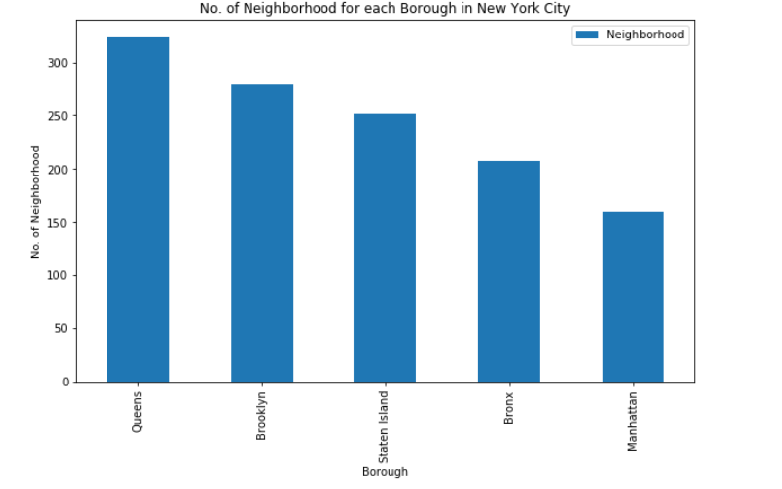
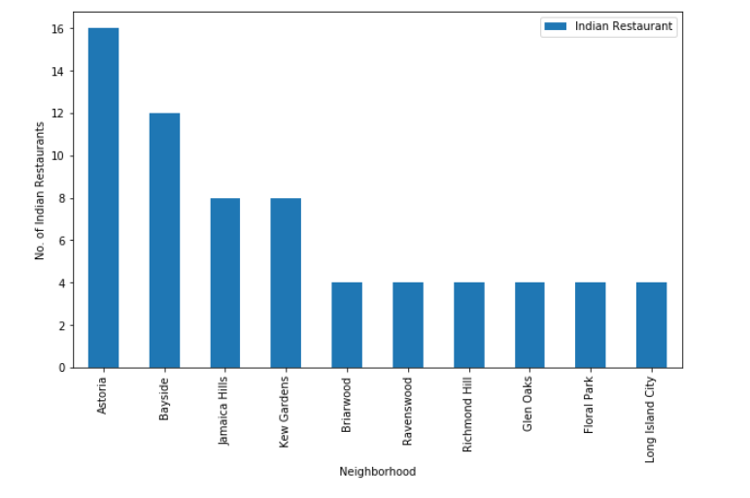
Visualization
No. Of Neighbourhood for each Borough in New York city
Distribution of Indian Restaurants across different Neighbourhoods

Slide 6
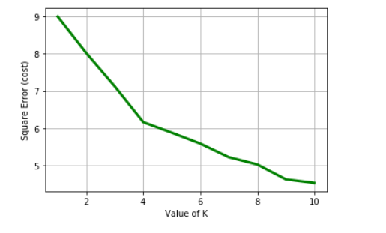
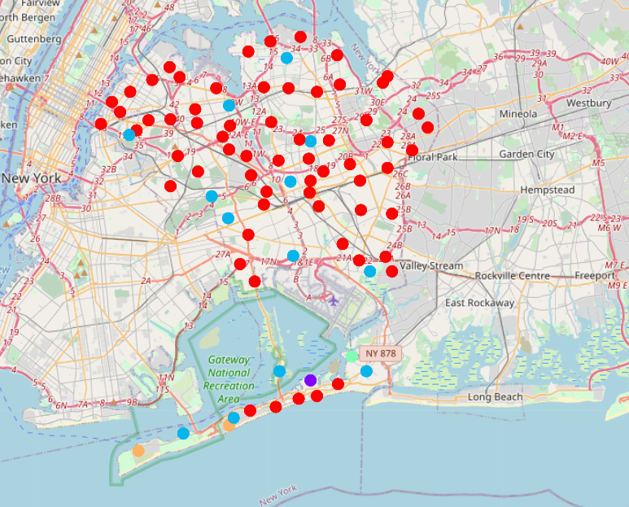
Clustering the Neighbourhood
We will extract Indian restaurant data from above table and fit this into the code for finding best value of K.
The 4 Clusters which can be visualized using the Folium Library

Slide 7
Results and Discussion
The results of the exploratory data analysis and clustering is summarized below:
Astoria neighbourhood has the highest number of Indian restaurants.
Jamaica Estates neighbourhood has a high density of Indian restaurants.
Cluster 0 neighbourhoods have the least number of Indian restaurants.
I will open my restaurant in **South Ozone Park** neighbourhood because it is near International Airport. Because all immigrants will come to the nearest restaurant. So, the profit will be more.

Slide 8
Conclusion
Finally, to conclude this project,
we have got a small glimpse of how real-life Data science project looks like.
Usage of python libraries to handle JSON file, plotting graphs, and other exploratory data analysis.
Use Foursquare API to major boroughs of New York City and their neighbourhoods.
Potential for this kind of analysis in a real-life business problem is discussed in great detail.
Also, some of the drawbacks and chances for improvements to represent even more realistic pictures are mentioned.
As a final note, all of the above analyses is depended on the adequacy and accuracy of Four Square data.
A more comprehensive analysis and future work would need to incorporate data from other external databases.

Slide 9
Thank You

